Slide 1


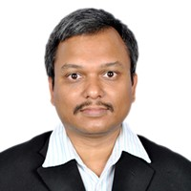


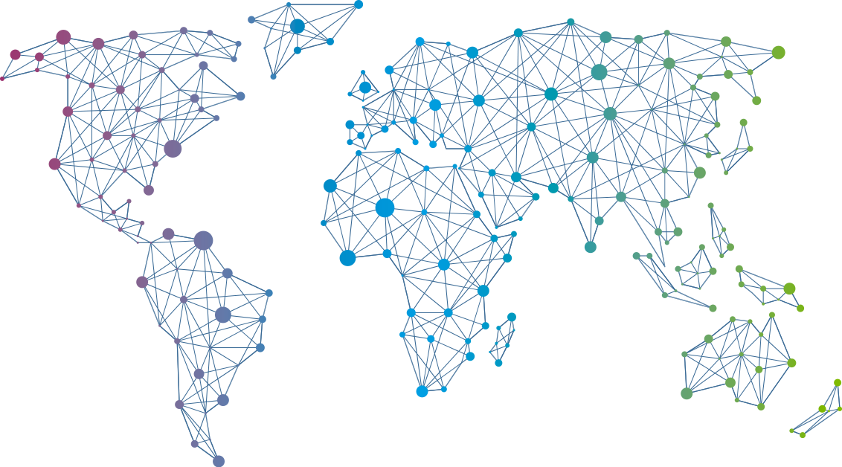

Speaker
Wriju Ghosh
Building Serverless Apps in Azure
Wriju Ghosh
wrijugh
September 16th & 17th
^{Online Event}
Powered By
International Conference

